Slide 1
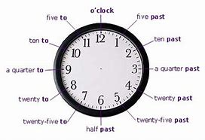
Converting between 12 and 24 hour time
EQ: If I have been alive for 76 years how many hours and days have past?

Slide 2

Quick refresher on how to read a clock

Slide 3
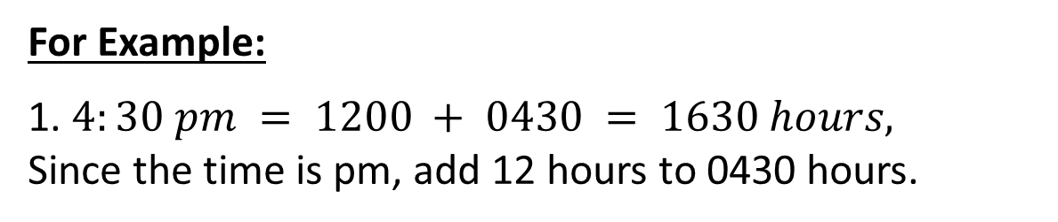
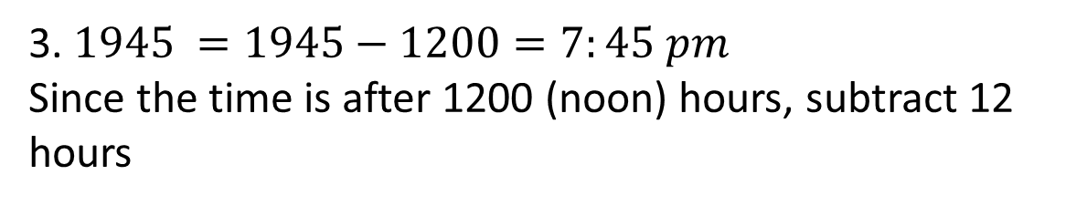
24
7
30
Units of Time
Date:
EQ: If I have been alive for 76 years how many hours and days have past?
What is 12 hours time?
Today we use
am – ante meridiem – Latin for (before noon) and
pm – post meridiem (after noon).
What is 24 hours time?
24-hr Time shows the number of hours and minutes after midnight.
For Example:
1. $4:30 pm = 1200 + 0430 = 1630 hours,$
Since the time is pm, add 12 hours to 0430 hours.
2. $7 am =0700 hours$
3. $1945 =1945−1200=7:45 pm$
Since the time is after 1200 (noon) hours, subtract 12 hours

Slide 4
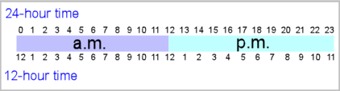
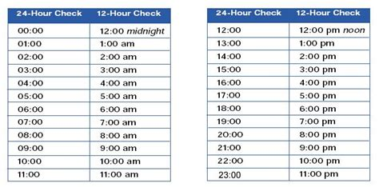
Several Guides I would recommend taking note of.

Slide 5
12 hour Time | 24 hour Time
6.00 pm
 | 1400
8.00 am
 | 2100
3.26 pm
 | 1236
11.09 pm
 | 2319
10.18 am
 | 0005
2.40 pm
 | 2149
1.30 am
 | 2020
11.59 pm
 | 1750
11.59 am

Slide 6
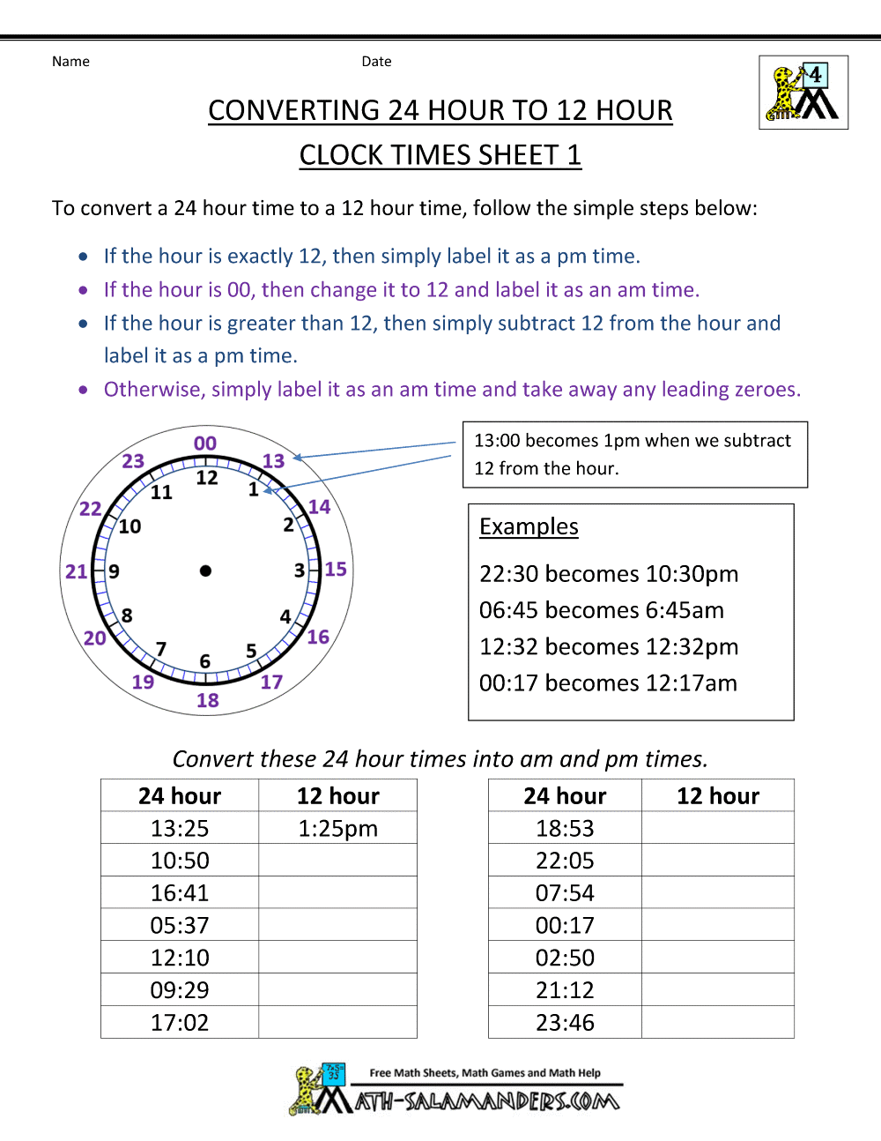
Complete the following worksheet

Slide 7
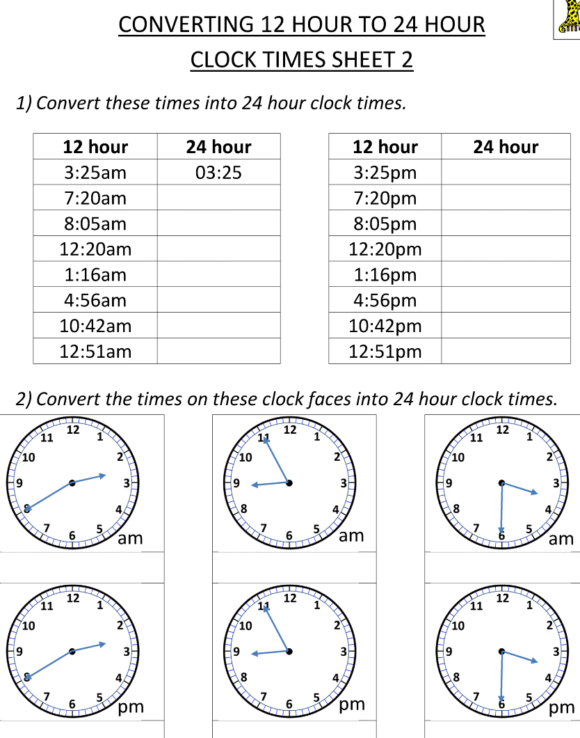
Complete the following worksheet

